Slide 2
Performance Improvements in .NET MAUI (.NET 7 edition)
Jonathan Peppers, Principal Software Engineer

Slide 3
Agenda: Performance!
Based on the post: http://aka.ms/maui-7-perf
For .NET 6 results and comparison to Xamarin, see previous post
Overall results in .NET 7
Quick recap on profiling .NET MAUI apps
Specific examples of performance improvements

Slide 4
Goals for .NET 6 & 7
800ms startup on a Pixel 5, .NET Podcast sample
1300ms (MAUI Previews) ➡ 812ms (.NET 6 / MAUI GA) ➡ 760ms (.NET 7)
10MB .ipa size for iOS, .NET MAUI template
17MB (MAUI Previews) ➡ 12.64MB (.NET 6 / MAUI GA) ➡ 12.48MB (.NET 7)
Pivot based on customer feedback:
What about startup on desktop platforms?
Android scrolling & layout performance

Slide 5
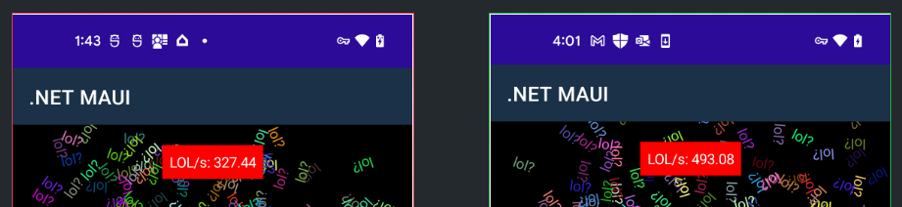
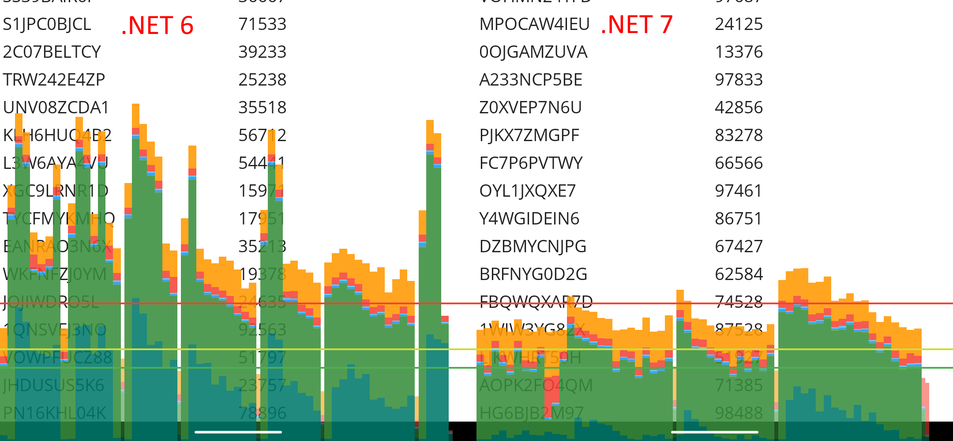
Android Layout & Scrolling Performance in .NET 7
https://github.com/jonathanpeppers/lols
CollectionView with 10,000 items
Each row contains two data-bound labels
It should scroll fast!

Slide 7
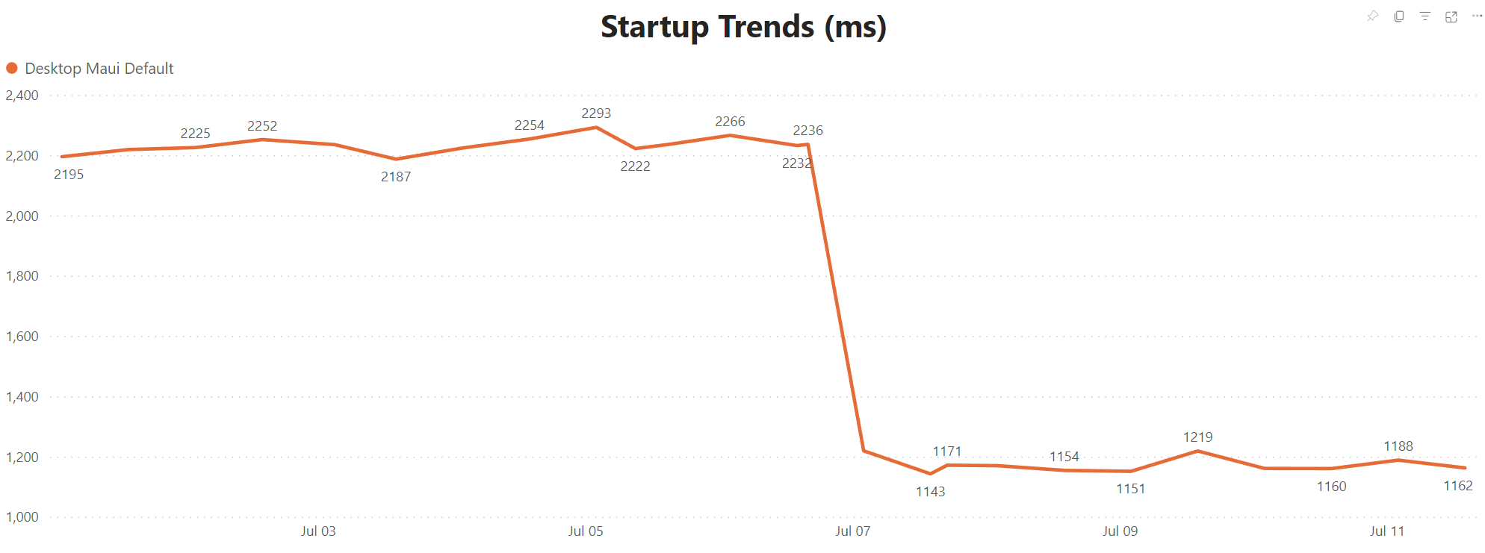
Desktop Startup Performance in .NET 7
Windows: Release builds use ReadyToRun by default
Example from .NET perf lab:
macOS/MacCatalyst: Release builds target both x64 and arm64 by default
In one instance, Apple’s Rosetta translation was taking 3-4 seconds for a .NET MAUI project.

Slide 8

Profiling & Measuring Startup

Slide 9
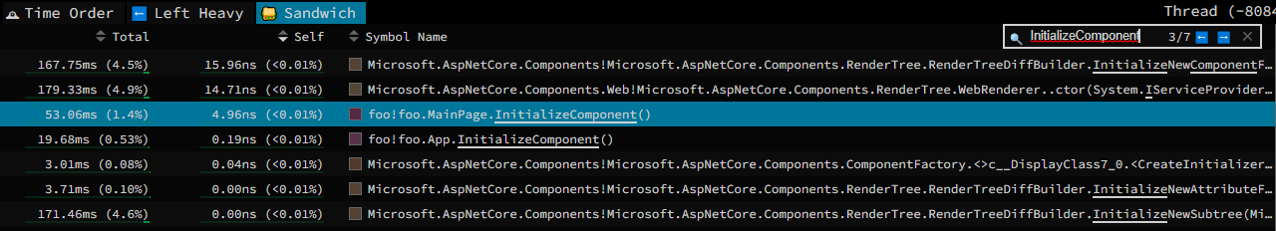
Profiling .NET MAUI Applications
https://aka.ms/profile-maui
We’re working on making this easier! Ideally in a future version of Visual Studio.
Example of dotnet-trace on Android:
adb reverse tcp:9000 tcp:9001
adb shell setprop debug.mono.profile '127.0.0.1:9000,suspend’
dotnet-dsrouter client-server -tcps 127.0.0.1:9001 -ipcc /tmp/maui-app --verbose debug
dotnet-trace collect --diagnostic-port /tmp/maui-app --format speedscope
https://speedscope.app

Slide 10
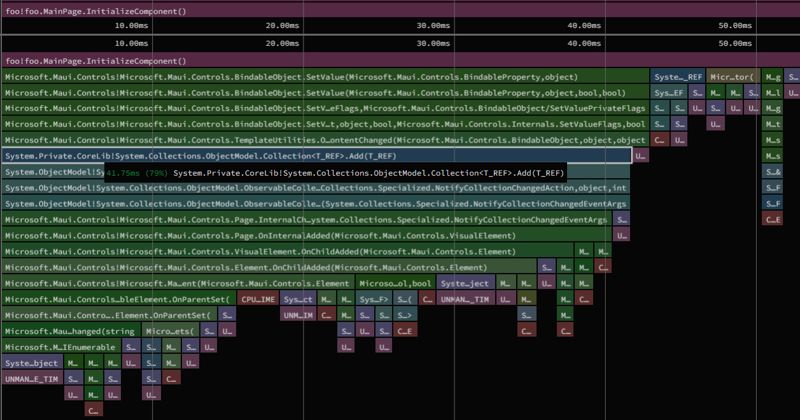

Slide 11
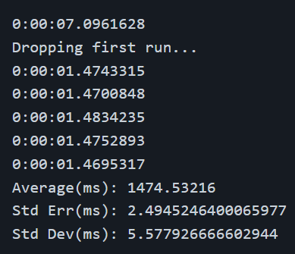
Measuring Startup Time in .NET MAUI
Always time Release builds!
https://aka.ms/profile-maui#measuring-startup-times
Android: ActivityTaskManager Displayed log message
iOS: Xcode & Instruments
Windows and macOS Desktop:
https://github.com/jonathanpeppers/measure-startup

Slide 12
Specific Examples: startup, scrolling, app size

Slide 13
Android NDK Compiler Flags
When we first got .NET MAUI running on early previews of .NET 7, we noticed a regression to both startup & app size:
A ~1.5MB increase in libmonosgen-2.0.so, the Android native library for the Mono runtime.
A ~250ms increase in startup time
In NDK23b, Google decided to no longer pass the -O2 compiler optimization flag for arm64 as part of the Android toolchain.
We tested three flags to compile libmonosgen-2.0.so in a dotnet new maui application:
-O3: 893.7ms
-O2: 600.2ms
-Oz: 649.1ms
https://github.com/dotnet/runtime/pull/68354

Slide 14
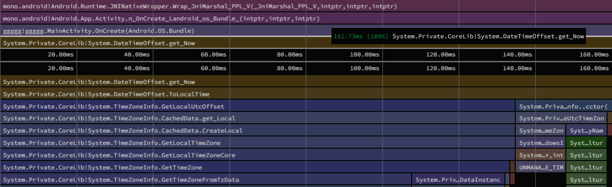
DateTimeOffset.Now and DateTime.Now
Use UtcNow if you don’t need local time!
We found a significant amount of time spent in the very first DateTimeOffset.Now call: ~277ms
Event after recording a custom AOT profile, we still saw ~161ms.
Instead:
Call an Android Java API for the current time offset. Our startup code in the Android workload is Java, so it can easily retrieve the value for use by the BCL.
Load timezone data on a background thread. This results in the original BCL behavior when complete, while using the offset from Java in the meantime.
This greatly improved DateTimeOffset.Now to a mere ~17.67ms
https://github.com/dotnet/runtime/pull/74459
https://github.com/xamarin/xamarin-android/pull/7331

Slide 15
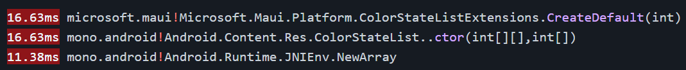
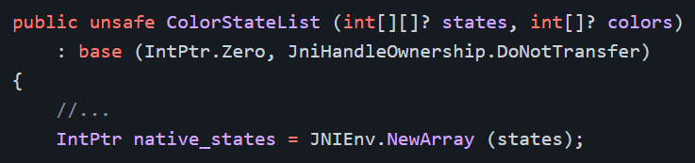
Avoid ColorStateList(int[][],int[])
dotnet-trace output of a .NET 6 ‘dotnet new maui’ application shows time spent creating Android ColorStateList objects:
You can see details about this method, reviewing the C# binding for this Java API:
Creates a Java array and copy each element.
Solution: move more of this code into Java!

Slide 16
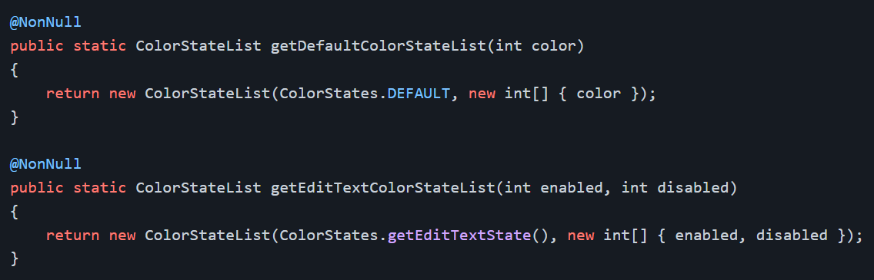
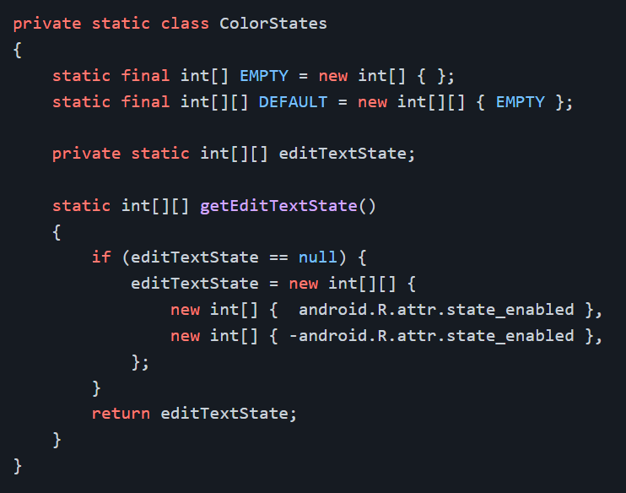
ColorStateList(int[][],int[]) Solution
Then in C#:

Slide 17
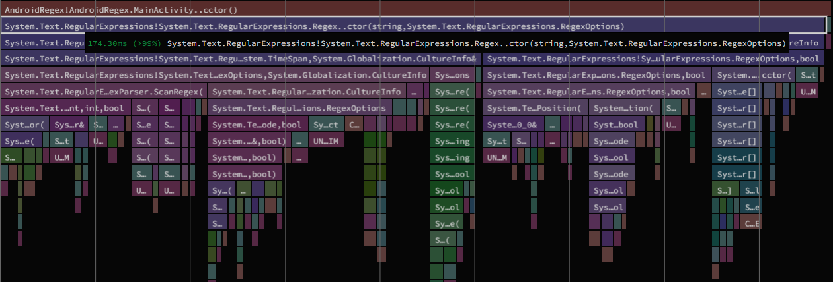
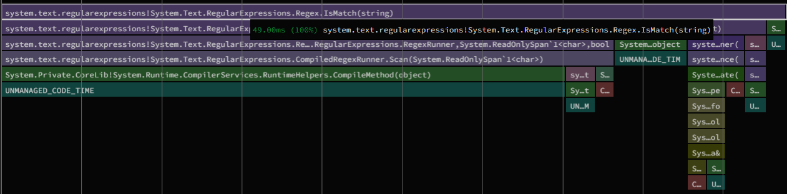
RegexOptions.Compile
Example of using RegexOptions.Compile:

Slide 18
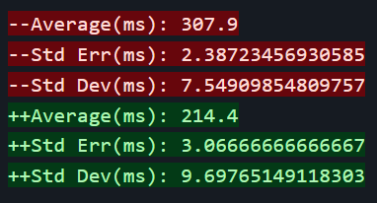
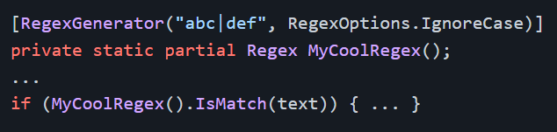
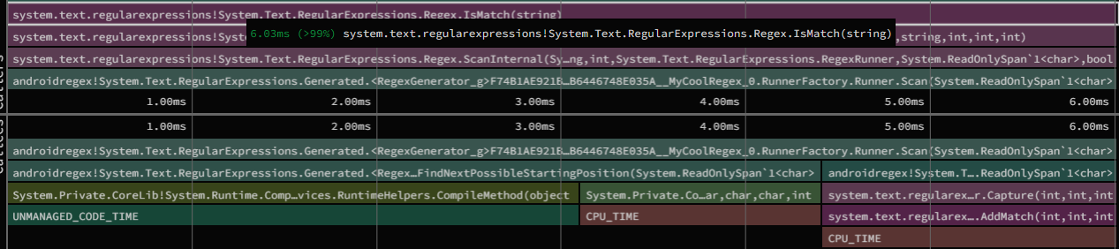
Better Regex in .NET 7 with Source Generators!
Rewrite such as:

Slide 19
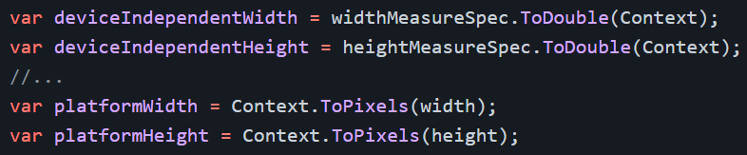
Avoid calling View.Context multiple times
dotnet-trace output of the LOLs/sec sample showed:
There is an interesting Java to C# interop implication in this call. Since the beginning of Xamarin.Android we've had the behavior:
C# calls a Java method, a Java object is returned to C#
Using the Handle of the Java object, find out if we have a C# object alive with the same Handle.
If not, create a new C# instance to wrap this object for use in managed code.
Improved LOLs/sec as well as CollectionView scrolling, etc.

Slide 20
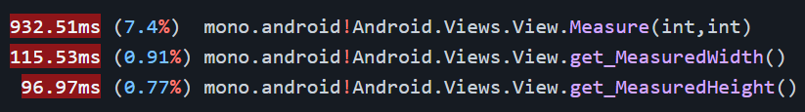
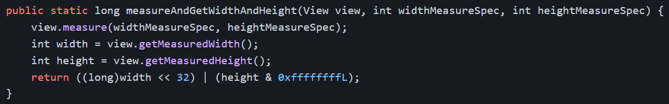
Reduce JNI Calls During Layout
While profiling the LOLs/second app:
Three C# to Java calls could be reduced to one:
Unpacking the values in C# as:

Slide 21
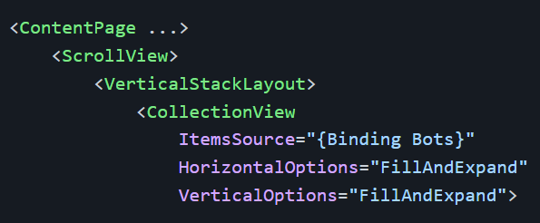
Notes on CollectionView
As seen in issue dotnet/maui#6317, a CollectionView with 10,000 rows contributed to poor startup time and slow scrolling performance.
In this case, the sample app on a Pixel 5 would start in:
.NET 6: 16s412ms
.NET 7: 14s642ms
That is really slow!
Simply remove ScrollView/VSL
Drastically improved ~822ms (94% shorter!)
Improving this in future .NET releases

Slide 22
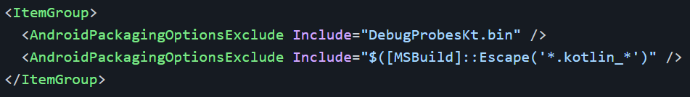
Exclude Kotlin-Related Files from Apps
Google's AndroidX libraries are bringing more and more APIs implemented in Kotlin instead of Java. One result of this change, is additional "stuff" added to Android .apk files.
.NET 6 “dotnet new maui” apps contain:
“kotlin” directory: 386,289 bytes uncompressed, 154,519 bytes compressed
“DebugProbesKt.bin”: 1,719 bytes uncompressed, 777 bytes compressed
By default, the Android workload adds:
This feature can also be used to exclude other files, check out your .apk in your favorite zip file utility or Android Studio.

Slide 23
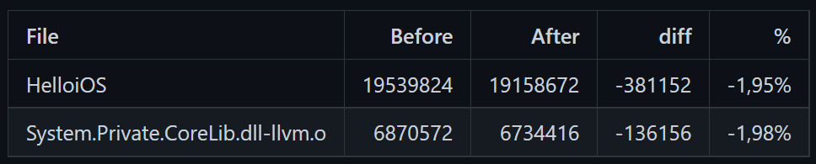
Improve AOT Output for Generics
To improve the generated AOT code size of .NET 7 iOS applications, the following cases are now implemented:
If a generic method or a method of a generic type has all type parameters constrained to value types - methods for reference types will not be generated.
If a generic method or a method of a generic type has all type parameters constrained to reference types - methods for value types will not be generated.
In both cases, we were generating AOT code for methods that were not possible to be called. This is impactful for a large assembly like System.Private.CoreLib.dll.
The results of this change in a "hello world" iOS application:

Slide 24
Themes for .NET 8
Fundamentals in .NET MAUI: bugs! 🐛
Further work on layout and scrolling performance
Developer Inner Loop
Hot Reload reliability & user experience
Build/deploy times

Slide 25
Thanks!
http://aka.ms/maui-7-perf

